Slide 1
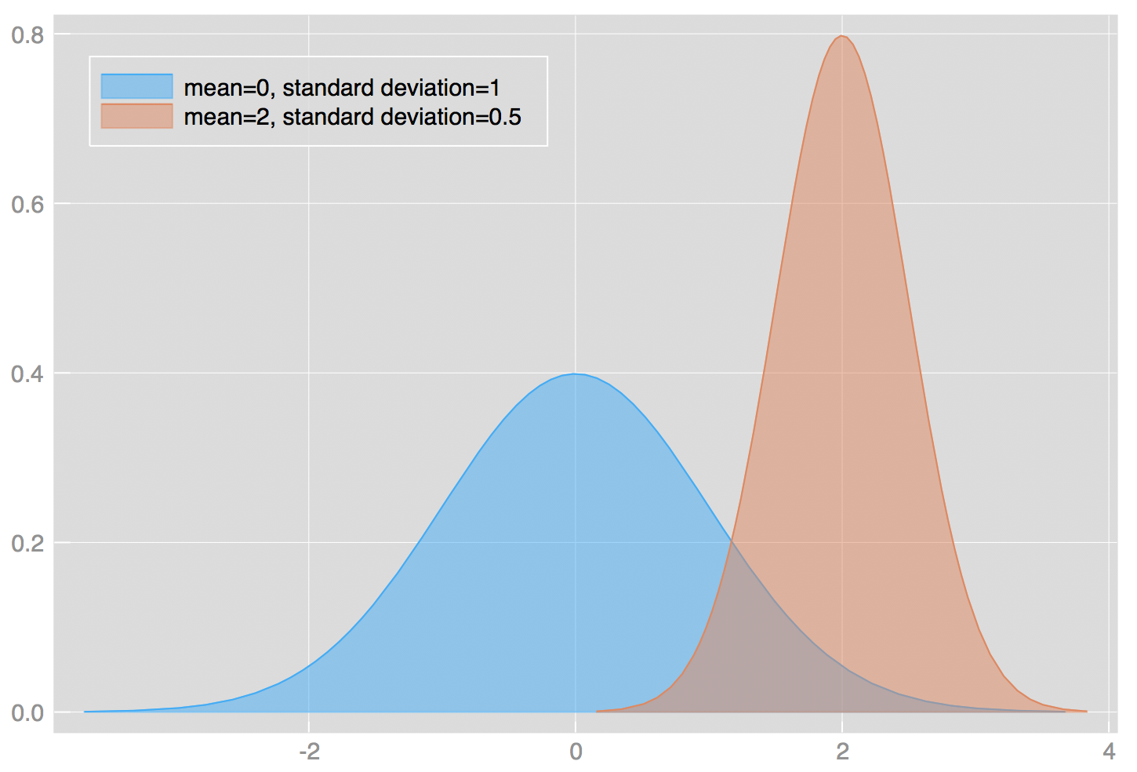
Week 6: Probability and Z/T scores
Geog4300: Shannon

Slide 2
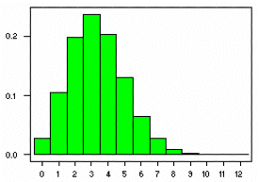
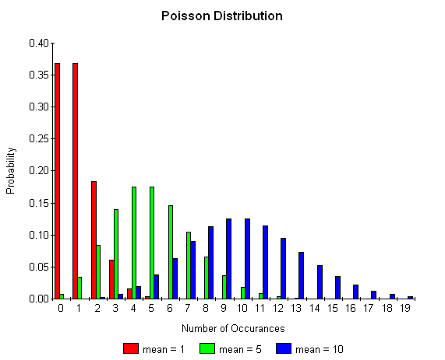
This week
Binomial/Poisson probability distributions
Z scores and T scores

Slide 3
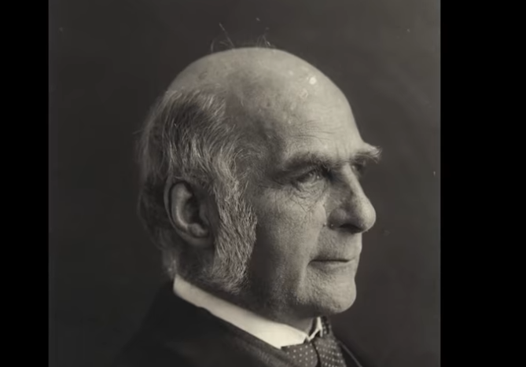
Let’s talk about the social history of statistics…
Francis Galton
https://www.youtube.com/watch?v=JeCKftkNKJ0

Slide 4
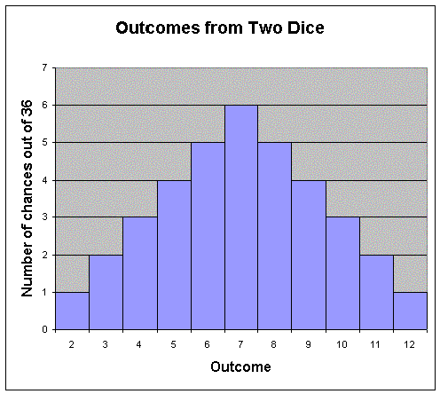
Probability distributions
How likely was an observed outcome?

Slide 5

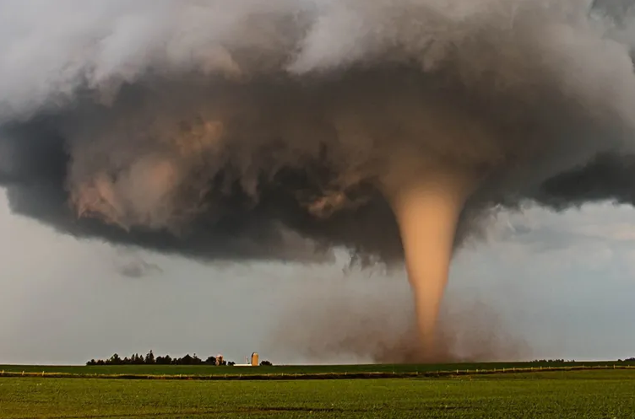
Binomial distribution:
How many “successes” in a set number of trials?
Poisson distribution:
How many times will a given event occur randomly over a period of time?

Slide 6
Binomial distribution
n! p^{x} q^{n-x}
P(x) =
x! (n-x)!
X= # of “successes”
N= # of trials
P = probability of success
q = probability of failure

Slide 7
Binomial distribution
Dice roll probabilities
2 | 1/36 (2.778%)
3 | 2/36 (5.556%)
4 | 3/36 (8.333%)
5 | 4/36 (11.111%)
6 | 5/36 (13.889%)
7 | 6/36 (16.667%)
8 | 5/36 (13.889%)
9 | 4/36 (11.111%)
10 | 3/36 (8.333%)
11 | 2/36 (5.556%)
12 | 1/36 (2.778%)
n! p^{x} q^{n-x}
P(x) =
x! (n-x)!
X = # of “successes”
N= # of trials
P = probability of success
q = probability of failure
What’s the probability that you will roll a 4 or less in 3 rolls?
What’s the probability that you’ll roll an 8 or greater?

Slide 8
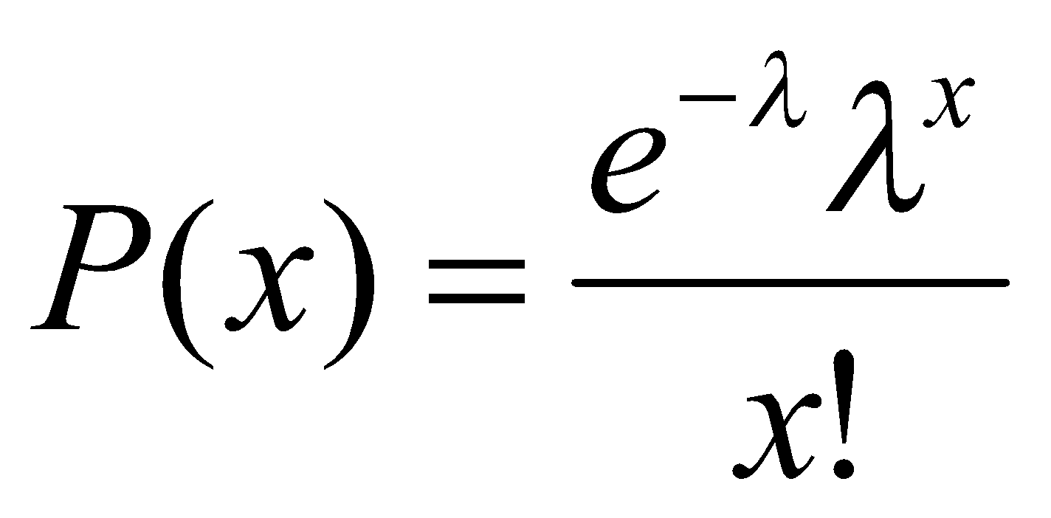
Poisson distribution
λ = rate of occurence per unit time
x = # of occurrences you are testing for
e = 2.71828
Given that Georgia has an average of 21 tornadoes per year, what is the probability of a given year having exactly 15 tornadoes?

Slide 9

Concept check
The town of Chewandswallow receives random spaghetti storms two days out of every week on average.
A neighborhood group is planning an Italian picnic. What is the chance it will receive three storms in the week prior to this event, so they won’t have to cook?

